Slide 1
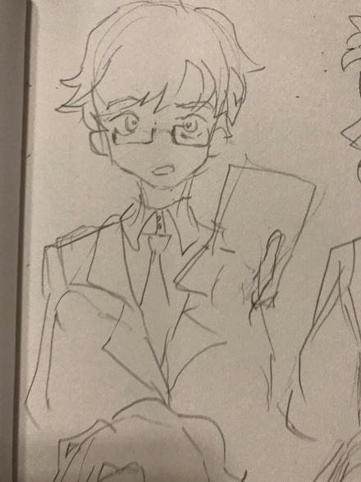
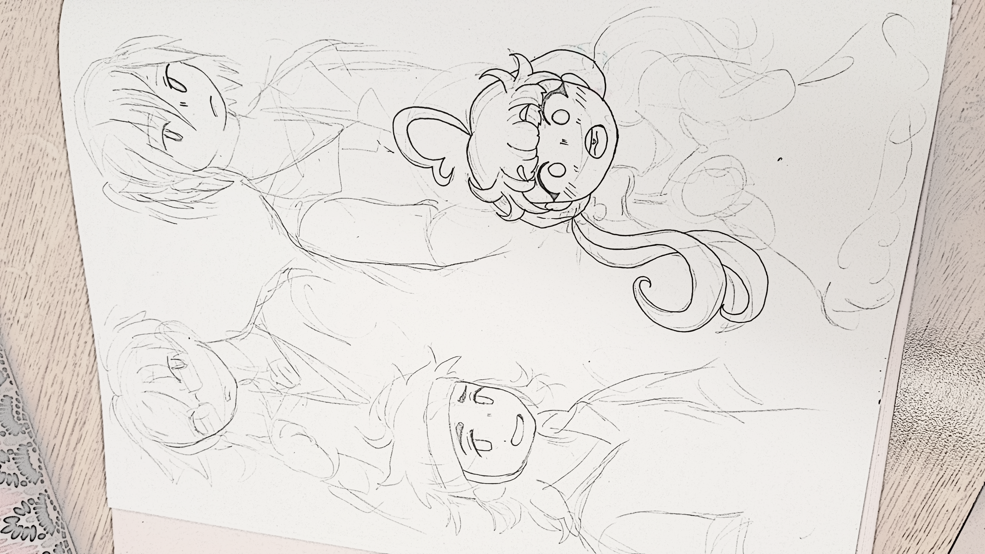
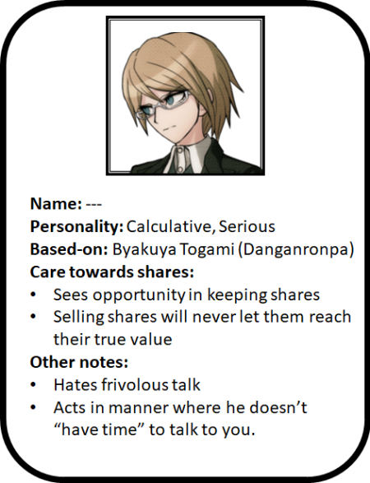
Name: “Jack Hanson”
Personality: Calculative, Serious
Reference: Byakuya Togami (Danganronpa Series)
Notes:
Hates frivoulous talk
Acts in a manner where he doesn’t “have time” to talk to you
Sees things very logically
Sees opportunity in keeping shares
“If I sell these shares now, they will never reach their true value”
Reference:

Slide 2
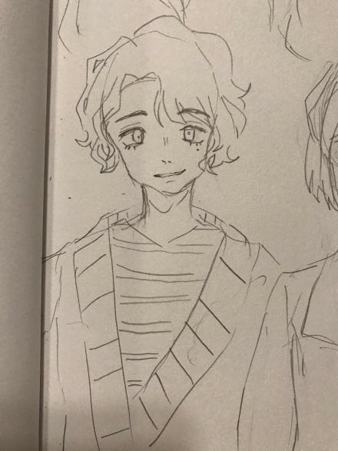
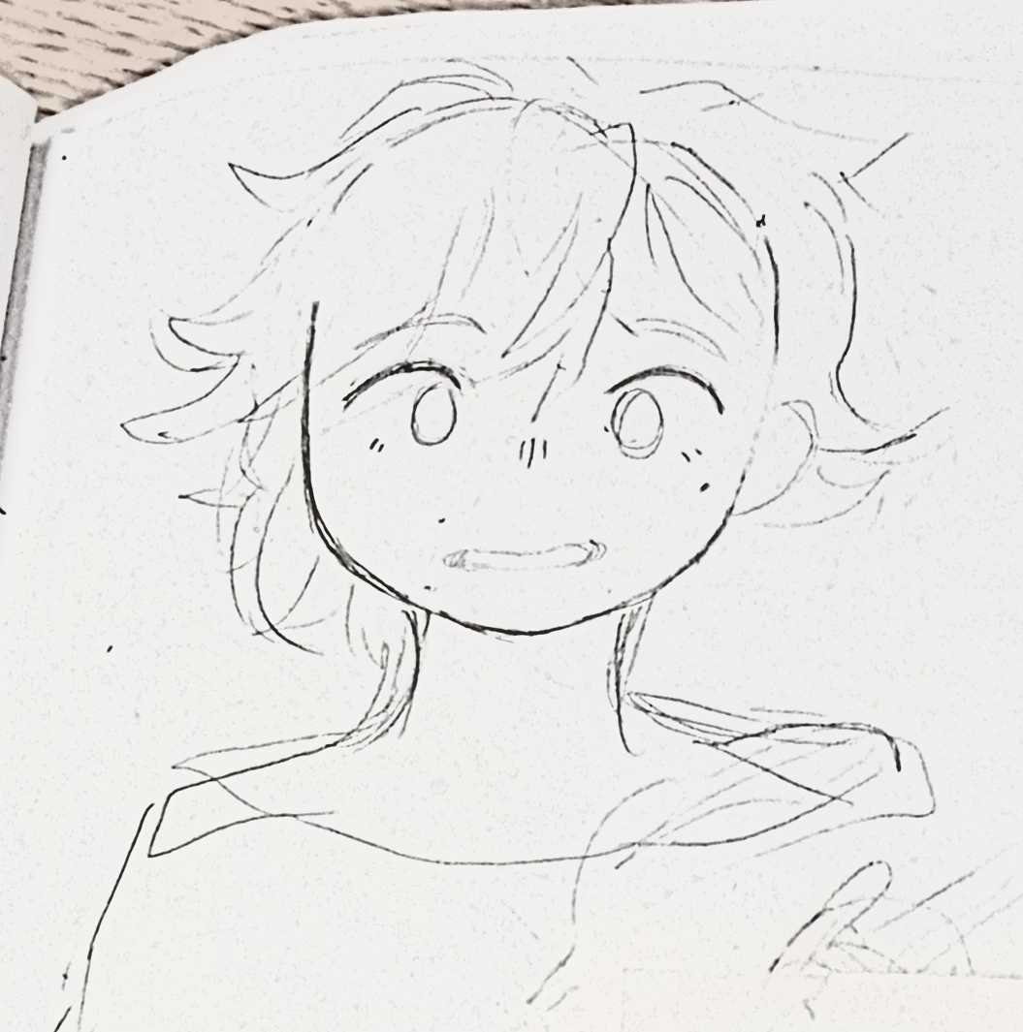
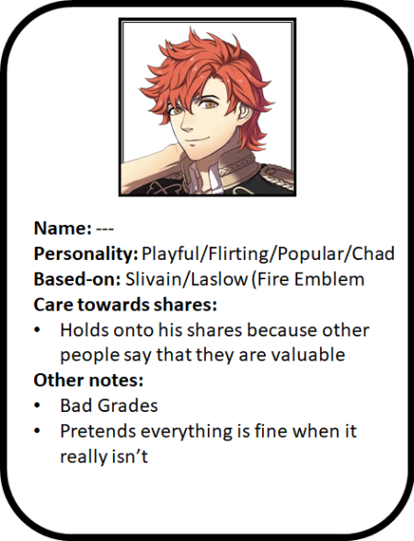
Name: “Chad Barton”
Personality: Playful/Flirting/Popular/Chad
Reference: Silvain/Lazlow (Fire Emblem Series)
Notes:
Bad grades
Pretends everything is fine when it really isn’t
Likes testing people he meets
Does things because other people say that you should do it/”it’s popular”
Reference:

Slide 3
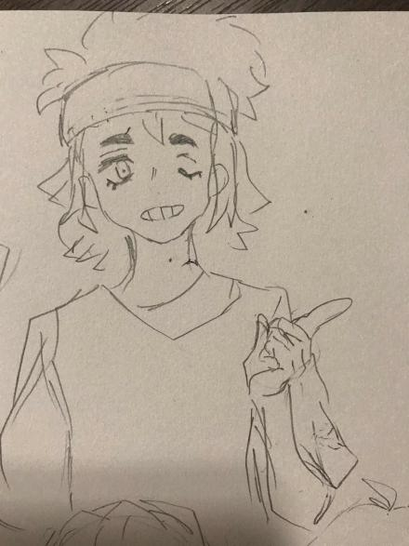
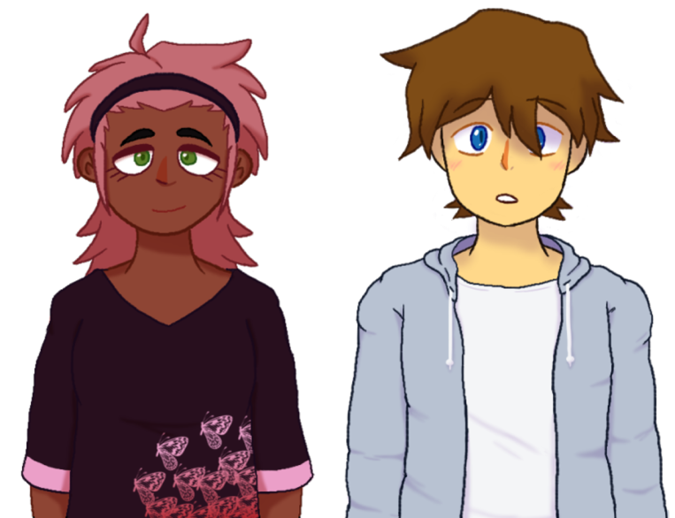
Name: “June Hanenburg”
Personality: Lazy/Easygoing, sassy
Reference: None
Notes:
Daughter of EaVille’s head of affairs
Could care less about company affairs (?)
Might even give you the shares if you ask nicely
Will try to give the protagonist a hard time whenever possible

Slide 4
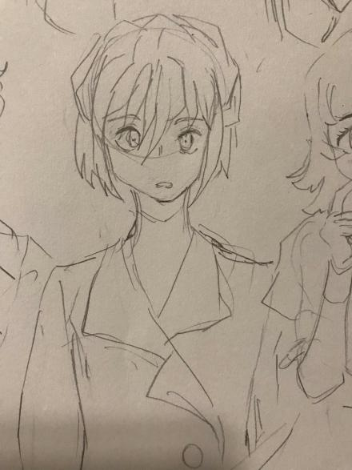
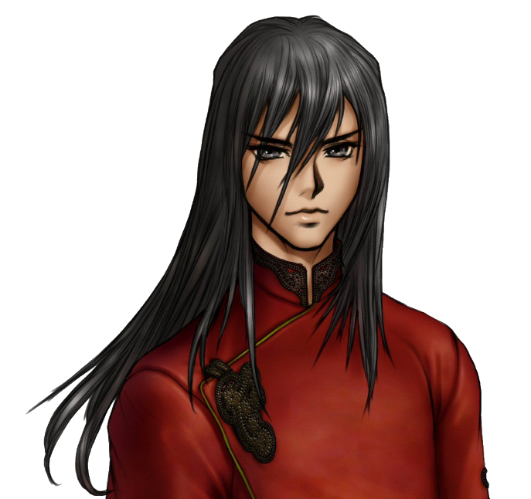
Name: “Shaun Ron”
Personality: Serious, Edgey
Reference: Navarre/Felix (Fire Emblem Series)
Notes:
Hates you and your smug attitude
Went through some sort of attitude
Defiant towards school
Reference:

Slide 5
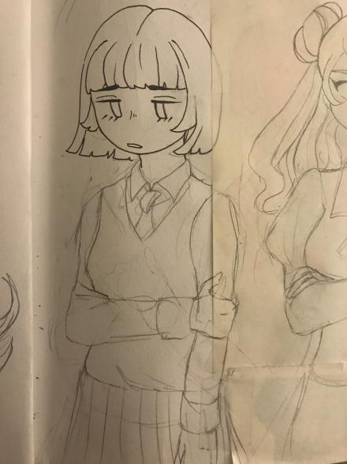
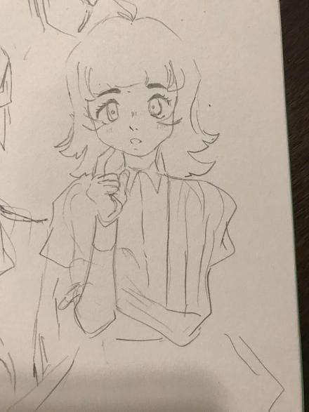
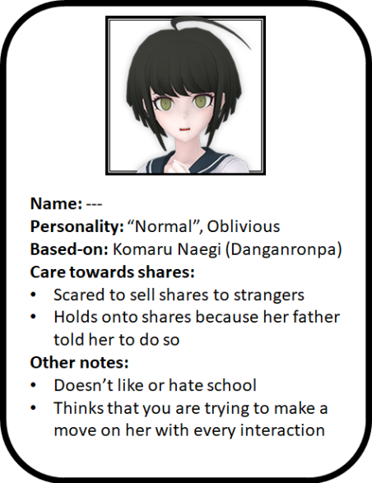
Name: “Claire”
Personality: Shy, Worried, Oblivious, “Normal”
Reference: Komaru Naegi (Danganronpa Series)
Notes:
Scared of strangers
Doesn’t like talking with strangers, much less trading stock
Indifferent towards school
Thinks that you are making a move on her with every action
Reference:

Slide 6
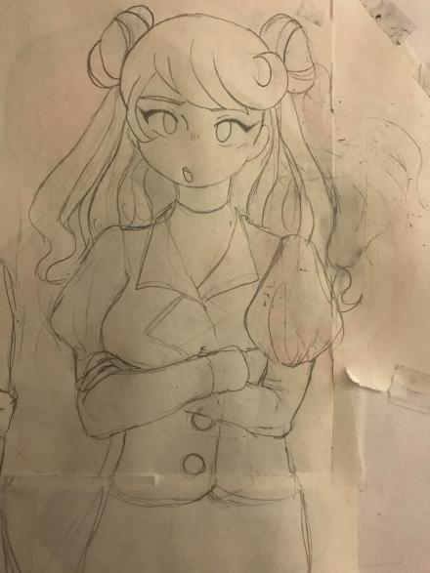
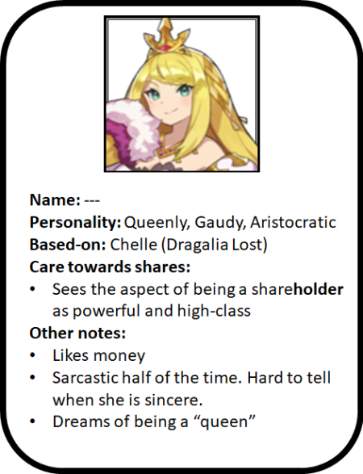
Name: “Samantha Parker” or “Sam”
Personality: Queenly, Gaudy, Aristocratic
Reference: Chelle (Dragalia Lost Series)
Notes:
Likes power
Sees the aspect of being a shareholder as powerful
Likes money
Sarcastic half of the time
Dreams of being a queen
Actually pretty stupid, but her personality hides it.
Reference:

Slide 7
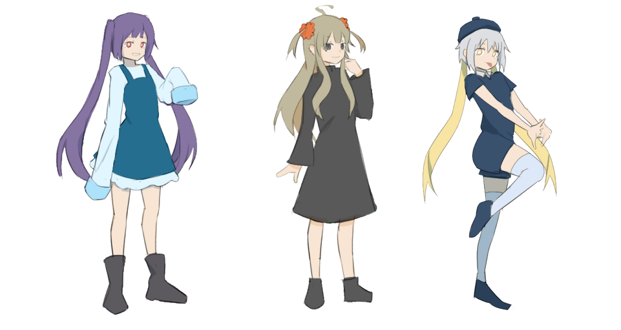

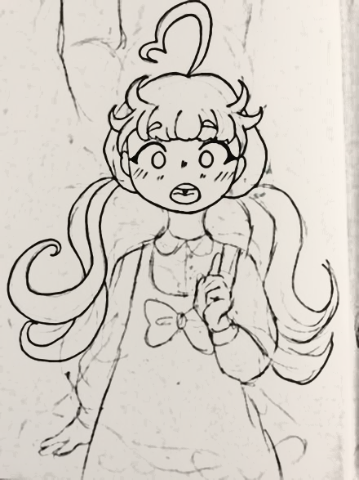
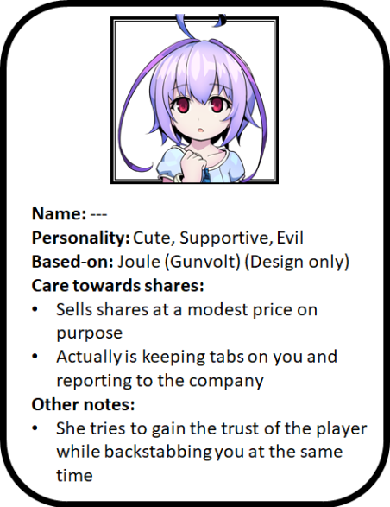
Name: “Anna Wilson”
Personality: Cute, Supportive, Secretly evil
Reference: Joule (Gunvolt Series) (Design only)
(Feel free to look at Hiyoko Saioniji from Danganronpa for inspiration)
Notes:
Acts nice to the protagonist (ex: sells shares at a low price)
Keeps tabs on the protagonist
Reports you to EaVille
Tries to gain trust while backstabbing at the same time, possibly because EaVille promises a bounty or something?
Reference:

Slide 8
Name: “Simon Miller” (The protagonist)
Personality: ???
Notes:
Shouldn’t have a very strong personality
Some genius inventor that really doesn’t know how to put his stuff to use
Has social skills, but really never used them before (does not have a big friend base).

